Slide 1
Getting technical help from online (R/stats) communities
MLW R Book Club
McEwen Khundi
3September2021

Slide 2
What do you usually do when you are stuck with code
Check function help
? Mean
Package vignette

Slide 3
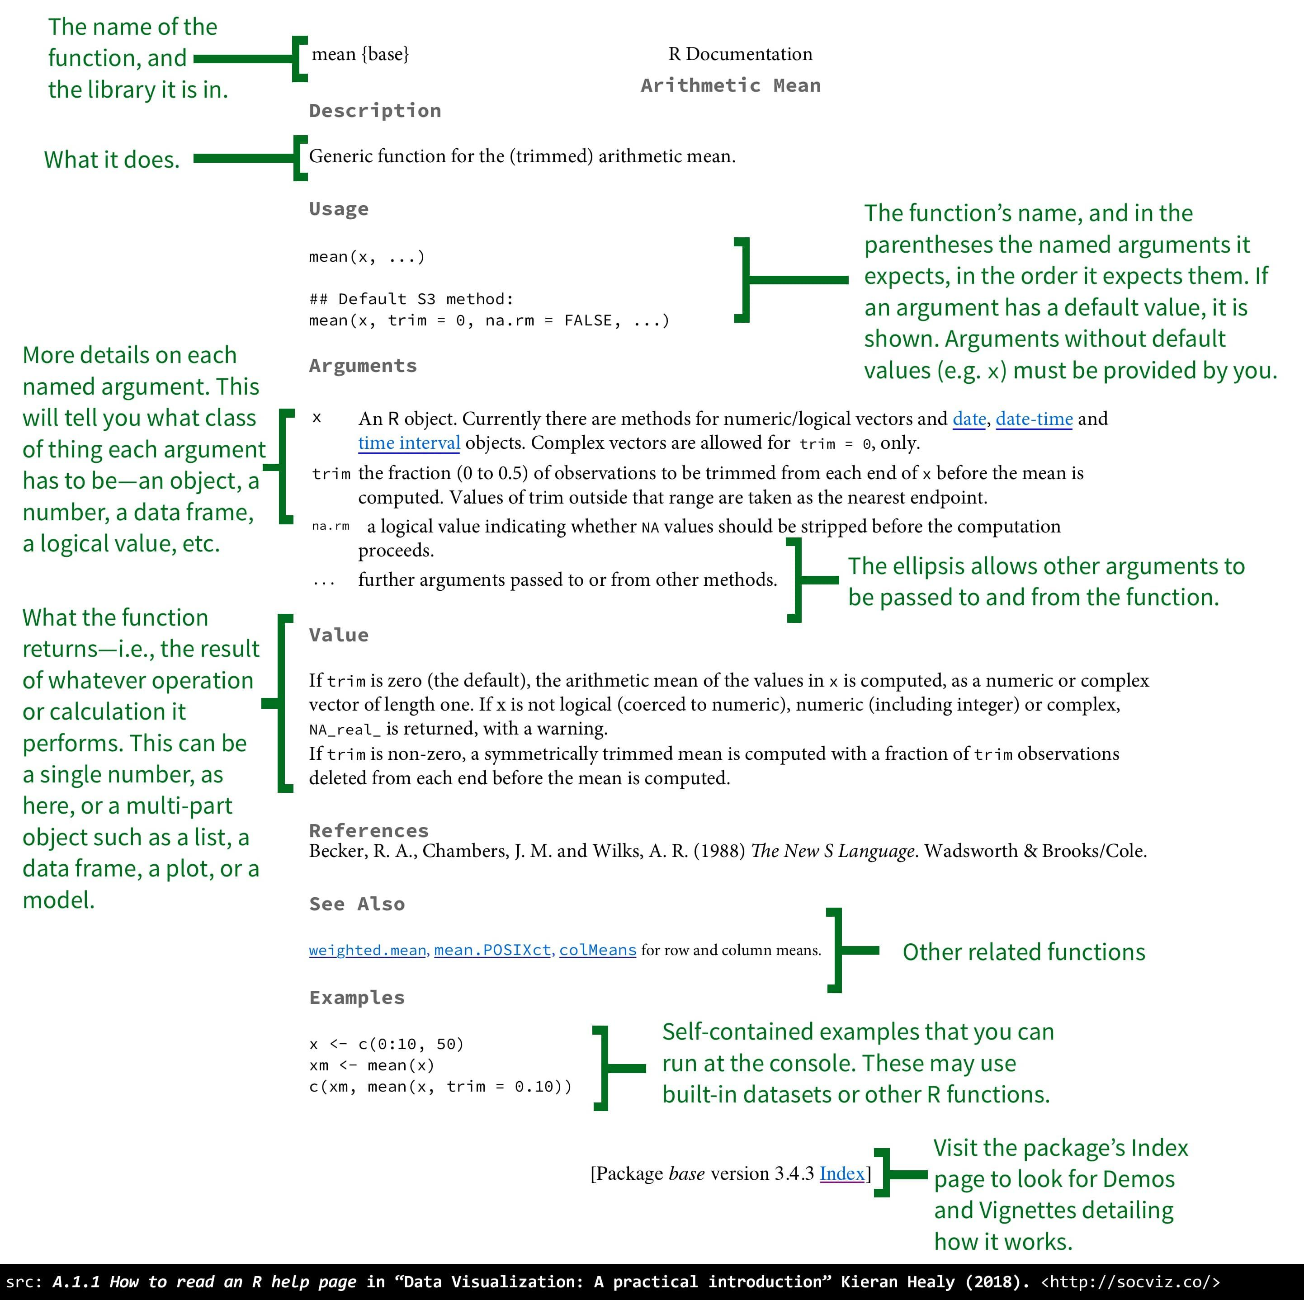
Function help page (?mean)

Slide 4
Package vignette
Has basic steps of how to complete a specific task using a package
A package can have several
Some packages don’t have any
Example table summary (dplyr package)
https://cran.r-project.org/web/packages/dplyr/index.html
Reference manual is a could be described in brief as a package dictionary.

Slide 5
If still If still search online
Blogs with solutions
Sometimes these have a comment section where you can engage with the author
Online help communities
Examples on the following pages

Slide 6
Stackoverflow
Online community of question and answer for coders
Most questions have already been answered
If you have reasonable doubt that the question you are asking has not been asked before prepare a reprex and submit a question.
Refer to last weeks meeting on how to do a reprex in r

Slide 7
Example
Go to stack overflow
https://stackoverflow.com/questions/tagged/r

Slide 8
Cross validated
Question and answer site for statistics
https://stats.stackexchange.com/questions/tagged/regression?sort=frequent&pageSize=15

Slide 9
Stack exchange
Is a network of question and answer websites
Stack overflow
Cross validated
Self moderated with community leaders
Works by rewarding users points
Other stack exchange sites
https://biology.stackexchange.com/
https://gis.stackexchange.com/

Slide 10
R communities
Rstudio community
Started by the Rstudio
Questions rated to R mostly based on packages written by Rstudio employees (tidyverse)

Slide 11
Example
Go to https://community.rstudio.com/
Some example profiles
Peter MacPherson
https://community.rstudio.com/u/petermacp/summary
McEwen Khundi
https://community.rstudio.com/u/khundiman/summary

Slide 12
Slack and related software
Popular among small groups
School departments
We have our own MLW r bookclub slack

Slide 13
Best practices to get informative response
Make the question/problem reproducible.
Clearly demonstrate your attempt and mention where you are stuck.
Remove all other objects/vars that are unrelated to the specific question.
https://reprex.tidyverse.org/

Slide 14
Other communities
Most communities have an online help community where members help each other.
Examples
R ladies
https://rladies.org/ @RLadiesGlobal
@RLadiesNairobi
R4Ds online learning community @R4DScommunity
City R chapters
https://www.r-consortium.org/blog/2021/06/24/working-with-databases-in-r-video-presentation-from-nairobir-and-r-ladies-nairobi
https://africa-r.org/

Slide 15
Malawi based online communities
BlantyreR ? Or MalawiR
BlantyreR Ladies?
Data analysis blogs ?

Slide 16
Engaging directly with package authors
Go to github repo of package
Open issue
Only appropriate when the question you have can not be answered at other sites or you think you have discovered a bug
Example
https://github.com/easystats/insight/issues/415

Slide 17
Keeping up to date with the R community
Rweekly
https://rweekly.org/
Rbloggers
https://www.r-bloggers.com/
https://postsyoumighthavemissed.com/

Slide 18
Key message
Don’t be afraid to start participating in the online community
Most times people are kind even if you think your question is “stupid”
Almost “any technical question” you have there is someone on an online community who would be willing to help you.

Slide 19
Open discussion

